Slide 1
NoSQL: Meet the Family
David Rollins. Consultant, Slalom, L.L.C.
Twitter: @DavidRollinsTX
Notes:
Experience:
SQL Server DBA
Web Developer 10 years
Interested in NoSQL, little practical experience until recently
What I’ve learned…

Slide 2
Agenda
NoSQL
101
Relational
vs
NoSQL
Misconceptions
In the Wild
MongoDB
In Action

Slide 3
NoSQL 101

Slide 4
NoSQL = Not Just SQL
NoSQL DataStore:
Thinks in clusters
Persistent data (not just caches)
No fixed schemas
SQL “like” syntax
Eventual consistency

Slide 5





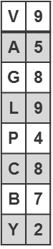
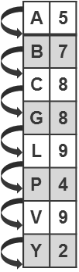
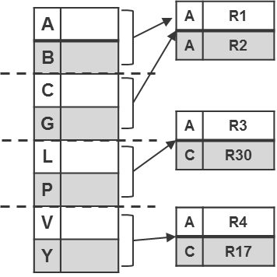

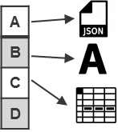
Types of NoSQL
Key-Value
Ordered
Key-Value
Big Table
Document
Graph
Notes:
NoSQL is a broad term used to describe specialized systems under one banner

Slide 6
Key-Value Store
Strength: Fast lookups
Weakness: Stored data has no schema
Examples:
DynamoDB
Redis
Riak
Voldemort
Key-Value
Ordered
Key-Value
Notes:
Key-value stores are generally good solutions if you have a
Simple application
with only one kind of object,
need to look up objects up based on one attribute.
The simple functionality of key-value stores may make them the simplest to use, especially if you’re already familiar with Memcached.

Slide 7
Big Table Store
Strengths:
Fast lookups
Good distributed storage of data
Weaknesses:
Very low-level API Example application:
Examples:
Apache Hbase
Apache Cassandra
Notes:
Model values as:
a map-of-maps-of-maps,
namely,
column families,
columns, and
timestamped versions.

Slide 8
Document Store
Strength: Tolerant of incomplete data
Weaknesses:
Query performance
No standard query syntax
Examples:
MongoDB
CouchDB
RavenDB
RaptorDB
Document
Notes:
Sample application:
A good example application for a document store would be one with multiple different kinds of objects (say, in a Department of Motor Vehicles application, with vehicles and drivers),
where you need to look up objects based:
on multiple fields (say, a driver’s name, license number, owned vehicle, or birth date).

Slide 9
Graph Store
Strength: Graph algorithms
e.g. shortest path, connectedness, n degree relationships, etc.
Weaknesses:
Has to traverse the entire graph to achieve a definitive answer.
Not easy to cluster.
Examples:
Neo4J
InfoGrid
Infinite Graph
Graph
Notes:
Any application that requires social networking is best suited to a graph database.
Interested in the relationship between Paul and Marry rather than knowing how many Bananas are left

Slide 10
Relational vs NoSQL

Slide 11
What’s wrong with Relational DBs?
NOTHING

Slide 12
Two Valid World Views
Relational View
Systems View
All about the data
Clean model
ACID Transactions
Easy long-term evolution
All about the system
Evolve modules
BASE Transactions
Flexibility

Slide 13
ACID vs BASE
ACID
BASE
Atomicity
All or nothing
Consistency
Moves from one known state to another
Isolation
Can’t see data from incomplete tx
Durability
Data from successful tx is not lost
Basically Available
Soft state
Eventually consistent
All nodes eventually see same data

Slide 14
CAP Theorem
Availability
Partition Tolerance
Consistency
Pick of 2 choices
Consistency – data is always the same
Availability – data is always available (r/w)
Partition tolerance – data exists across network partitions.
RDBMS
Notes:
Proposed by Eric Brewer; Professor, UC Berkeley; 2000
According to the CAP Theorem, you can only pick two.
Consistency means that each client always has the same view of the data.
Availability means that all clients can always read and write.
Partition tolerance means that the system works well across physical network partitions.

Slide 15
Relational
Column-oriented/Tabular
Key-value
Document-oriented
A
Availability:
Everyone can always read and write
CA
AP
MySQL
PostgreSQL
Vertica
Cassandra
CouchDB
SimpleDB
Dynamo
Voldermort
Pick Two
C
P
Consistency:
Same view of the data always
CP
Partition Tolerance:
Works well despite network partitioning conditions
Big Table
Hbase
MemecacheDB
Redis
MongoDB
Terrastore
15

Slide 16
Impedance mismatch
Difficulties that are arise when often encountered when a RDBMS is being used by a program written in an object-oriented style
Store XML in your DB?
Store data as blobs?
In reality:
I found that I now think relational
Document schema has been an adjustment

Slide 17
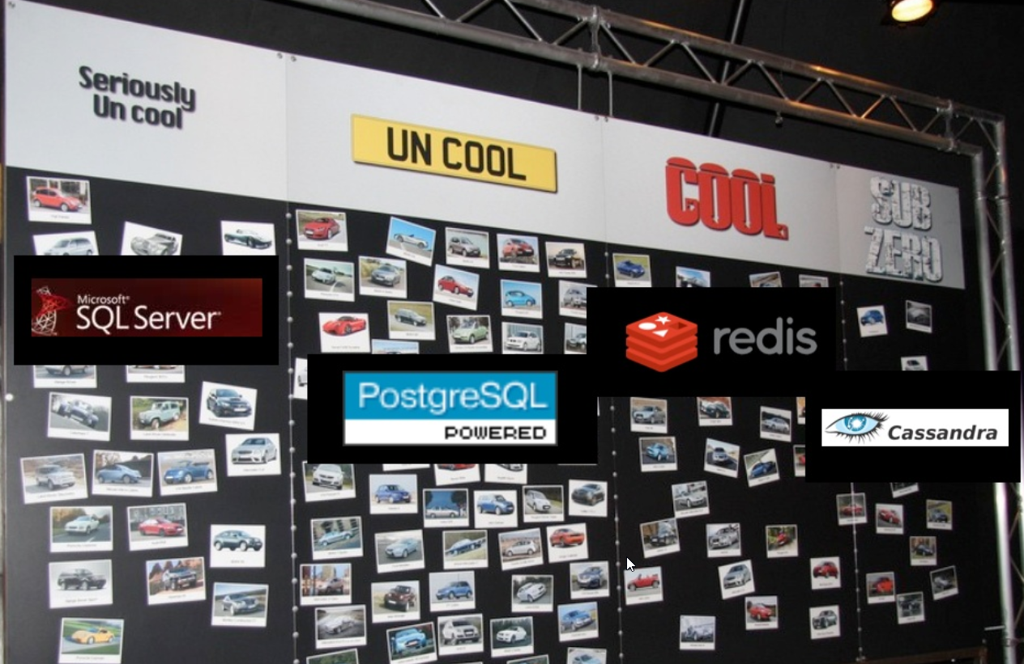
What’s really wrong with RDBMS?
Coolness Factor

Slide 18
Relational vs. NoSQL
Scaling

Slide 19
Scaling RDBMS
Reads Maxing out– Add caching
Writes Maxing out – Add hardware
Queries Slow – denormalize
Queries Still Slow – batch tables; stop joining
Writes slow – drop extra indexes and triggers

Slide 20
Scaling NoSQL
Just add more servers…
Well… that’s the promise.
Reality:
Pick the right shard key - Mongo
Elastic Search - >8G Index

Slide 21
Relational vs. NoSQL
Performance Comparison

Slide 22
Server Comparisons
Notes:
http://www.aptuz.com/blog/is-postgres-nosql-database-better-than-mongodb/
Remember that they are doing completely different things.

Slide 23
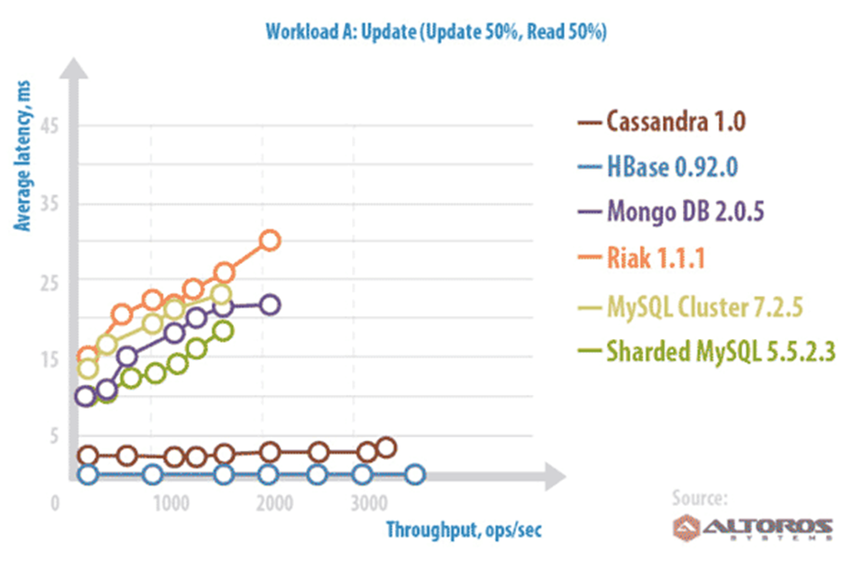
Server Comparisons-Update (50/50)
Notes:
BEST:
- Cassandra
- Hbase
Worst Latency:
- Riak
Worst Throughput:
- MySQL

Slide 24
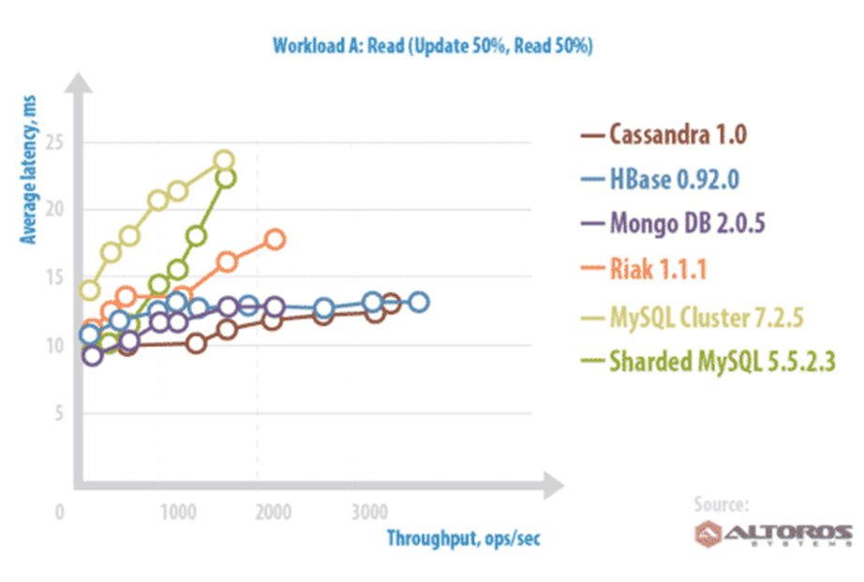
Server Comparisons-Read (50/50)
Notes:
BEST:
- Cassandra
- Hbase
Worst Latency:
- MySQL
Worst Throughput:
- MySQL

Slide 25
Misconceptions

Slide 26
Misconception 1
Replaces Relational DB
Augment! Don’t replace
Notes:
Analysis
Caching
Map reduce

Slide 27
















Misconception 2
Technology unproven
http://planetcassandra.org/companies/
http://www.mongodb.org/about/production-deployments/

Slide 28
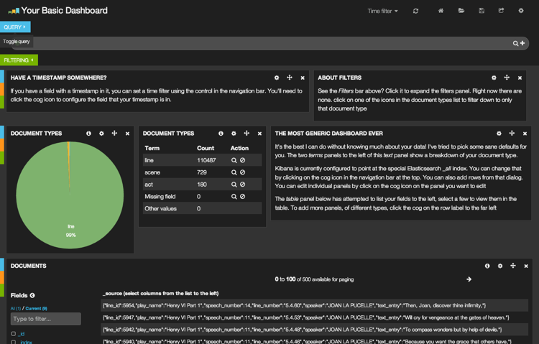
Misconception 3
That doesn’t apply to us
Caching
Prototyping
ELK Stack
Elasticsearch
Logstash
Kibana

Slide 29
In the Wild
Real World Project

Slide 30
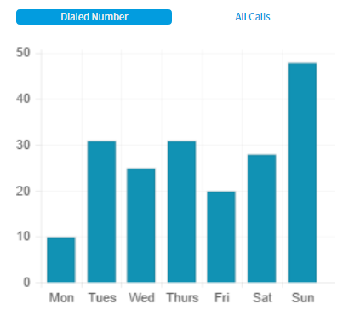
Augment Oracle Project
Oracle DB performance
3-5 seconds query response
6 billion records
Couldn’t run real-time reports
Nasty Joins on the queries
Augment with Elastic Search
ETL job feeds Oracle and ElasticSearch
“Google-like” queries
Aggregations to pull metrics

Slide 31
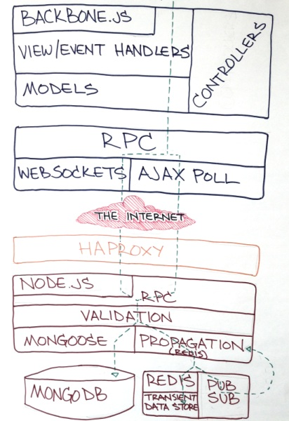
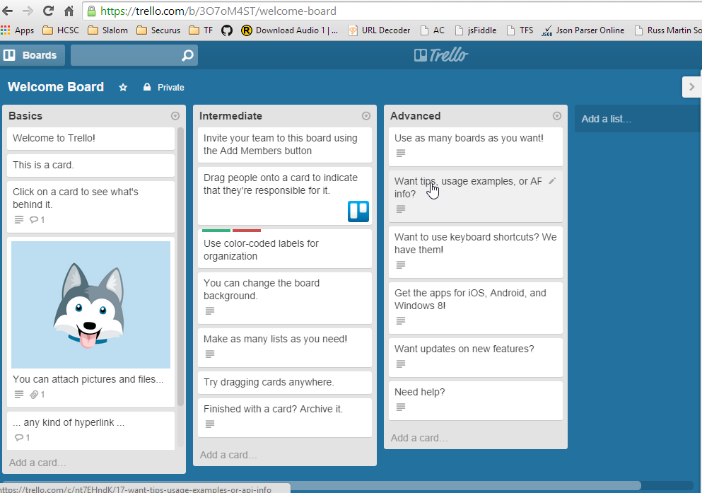
Trello.com
The Trello Stack

Slide 32









Slide 33
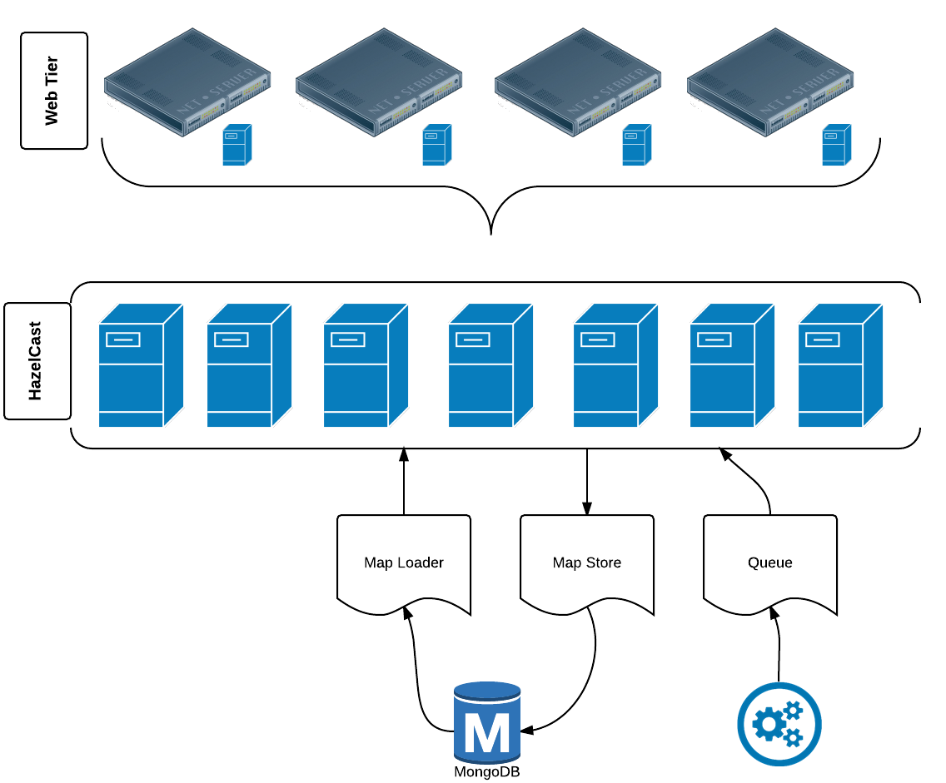

Slide 34
MongoDB
Details

Slide 35
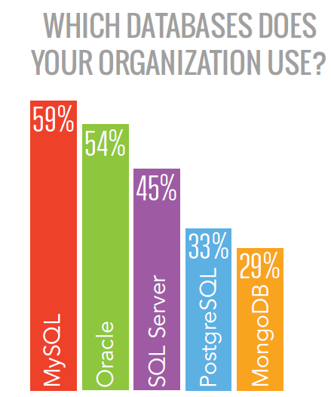
Why Mongo
Quick Sharding
Quick replication sets
Good documentation
Free on-line training
Trade-offs
Performance
Number of servers for replication
Scalability?
Source: Dzone BigData Research Guide

Slide 36

Full Index Support
Index on any attribute
Geospatial indexes
Replication & High Availability
Mirror across LANs and WANs for scale and peace of mind.
Sharding
Scale horizontally without compromising functionality.
Querying
Rich, document-based queries.
Complex queries through aggregates
GridFS
Store files of any size without complicating your stack.
Familiar Format
JSON style format saved as BSON

Slide 37
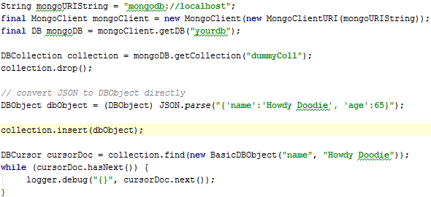
Java Client – Save JSON
Sample Output:
{ "_id" : { "$oid" : "51a6b568e15dd747023adeeb"}, "name" : "Howdy Doodie",
"age" : 65}

Slide 38
BSON vs JSON has some gotchas
ObjectId
Dates

Slide 39
MongoDB
Scaling

Slide 40
MongoDB – Replica Sets
One Primary Member; many secondary members
Auto-failover via majority election
Only write to primary
Optional to read from secondary
Member
1
Member
3
Member 2
PRIMARY
read
read, write
Client

Slide 41
MongoDB – Read/Write Concern
Write to OpLog before committing to DB!
Read (only when SlaveOK IS set)
Application
Replication
Write
OpLog
Read (only when SlaveOK IS set)
Replication
Read (only when SlaveOK IS set)

Slide 42
MongoDB – Sharding Players
shard1
shard2
shard3
mongod
mongod
mongod
The shards are the worker bees
The mongos is the boss
The config server is the record keeper
mongod
mongod
mongod
mongod
mongod
mongod
replica set
config servers
C1 mongod
C2 mongod
C3 mongod
mongos
mongos
…
client
…

Slide 43
Sharding Gotchas
Considerations before sharding with MongoDB:
Meta-data must be writeable for data to be repartitioned
(i.e. Config server up)
Choose sharding keys wisely
Some queries will use multiple shards

Slide 44
Managing Mongo is Hard!!!
Introducing MongoDB as a Service
Mongo Atlas:
MongoDB as a service
Choose your Cloud Provider
Mongo has tools for the heavy lifting and setup

Slide 45
In Action
Demo time!

Slide 46

Questions?
Slides & Presentation Material:
http://bit.ly/29BSc3l
SLALOM CONTACTS
David Rollins
Solution Architect
David.rollins@slalom.com
Twitter: @DavidRollinsTX

Slide 48
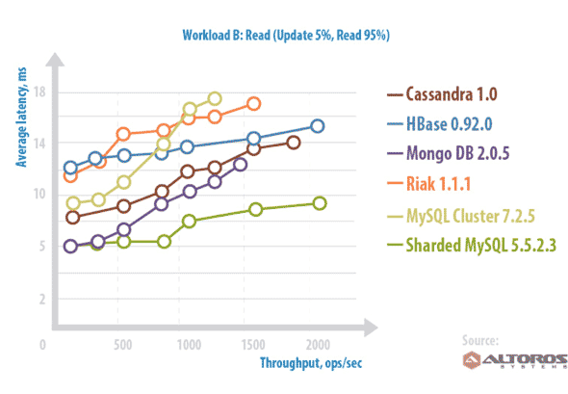
Server Comparison – Read (Read Heavy)
Notes:
BEST:
- MySql Sharded
Worst Latency:
- MySQL Cluster
Worst Throughput:
- MySQL Cluster
- Riak

Slide 49
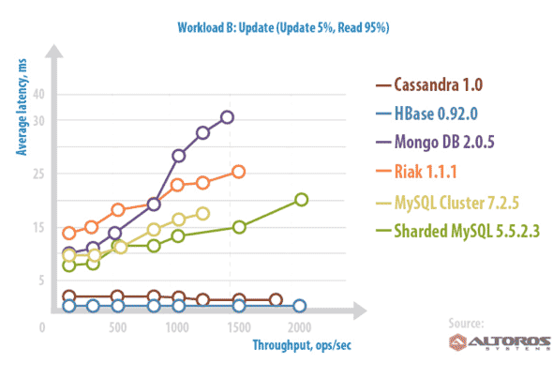
Server Comparison – Update (Read Heavy)
Big table
Document
Key-Value
RDBMS
Notes:
BEST:
- Cassandra
- Hbase
Worst Latency:
- MongoDB
Worst Throughput:
- MySQL Cluster

